Slide 1
January 2,2017
DO NOW : Write today’s objectives in your notes!
OBJECTIVES:
1.Evaluate how nationalism affected the nations
foreign policy after the War of 1812
2.Define what is meant by
The Era of Good Feelings
Homework
WEEK 6 - January 2-6
Read Chapter 7 - Section 1 and 2 Reading Checks Due Friday January 6th.
Section 3 and 4 Reading Checks Due Friday January 13th. (End of Marking Period)
Chapter Terms (p. 262) Due Friday January 13th.

Slide 2
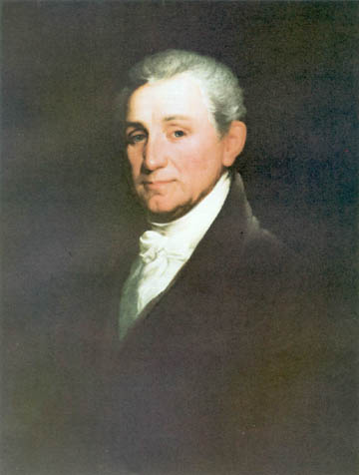
James Monroe’s Presidency

Slide 3
JAMES MONROE
1817 TO 1825
5th President
Era of Good Feelings
Monroe Doctrine
Sectionalism
President James Monroe
Notes:
Born in Virginia in 1758
Attended the College of William and Mary
Fought with Continental Army
Practiced law in Virginia
Elected United States Senator
Helped negotiate the Louisiana Purchase
Elected President in 1816 and served from 1817 to 1825
Era of Good Feelings

Slide 4
ERA OF GOOD FEELINGS
Cultural Nationalism
Patriotic themes infused every aspect of American society from books and paintings of Revolutionary heroes to Noah Webster’s blue-backed speller that promoted patriotism
Economic Nationalism
Running parallel with cultural nationalism was a political movement to support the growth of the nation’s economy--------AMERICAN SYSTEM
Political and Judicial Nationalism
Movement to bring about the support for national government is over the states. Supreme court decisions support the concept of national government over the states.

Slide 5
American Expansion
A series of treaties were signed in order to ensure the expansion of the United States:

Slide 6
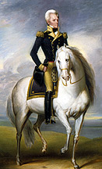
American Expansion
Florida Becomes Part of US
After War of 1812, Spain had difficulty governing Florida
Seminole Indians, runaway slaves, and white outlaws would conduct raids and then retreat to safety across the Florida border
President Monroe commissioned General Andrew Jackson to stop the raiders
Jackson led a force into Florida, destroyed Seminole villages, and hanged 2 Seminole chiefs
Jackson captured Pensacola and drove out the Spanish governor

Slide 7
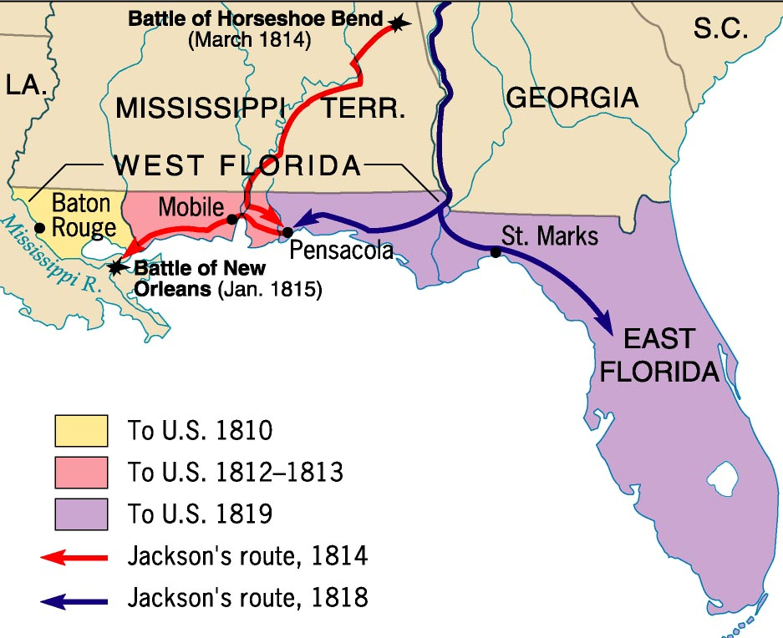

Slide 8
American Expansion
Adams-Onis Treaty (1818)
Spain:
Turned over western Florida along with all to the east
Gave up claims in the Oregon Territory to the U.S.
US agreed
to pay $5 million to Spain
to give up any territorial claims to Texas

Slide 9
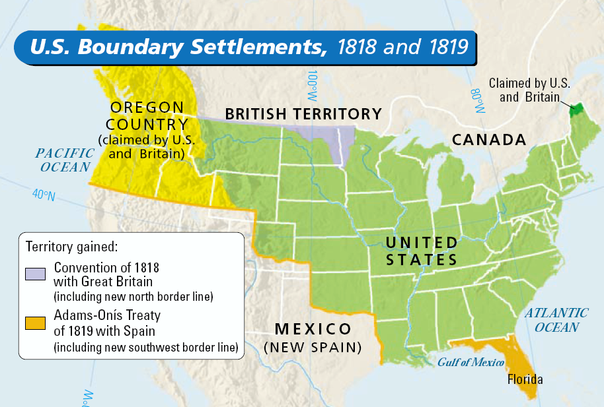
49th Parallel
Adams-Onis Treaty of 1819 with Spain
Texas

Slide 10
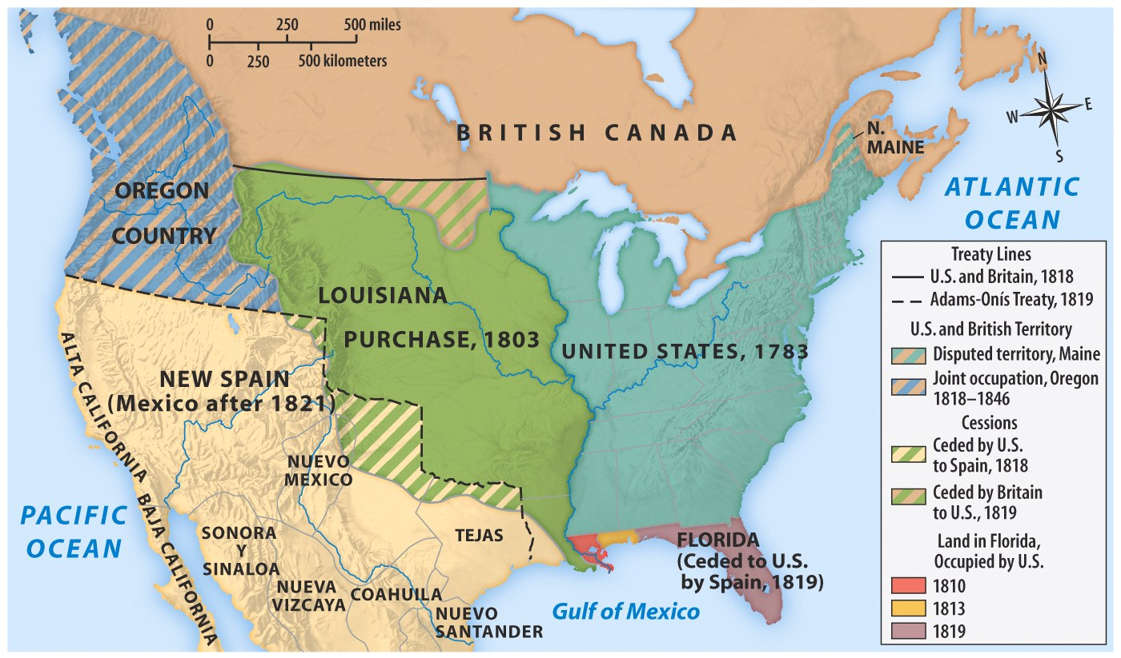
Rush-Bagot 1818

Slide 11
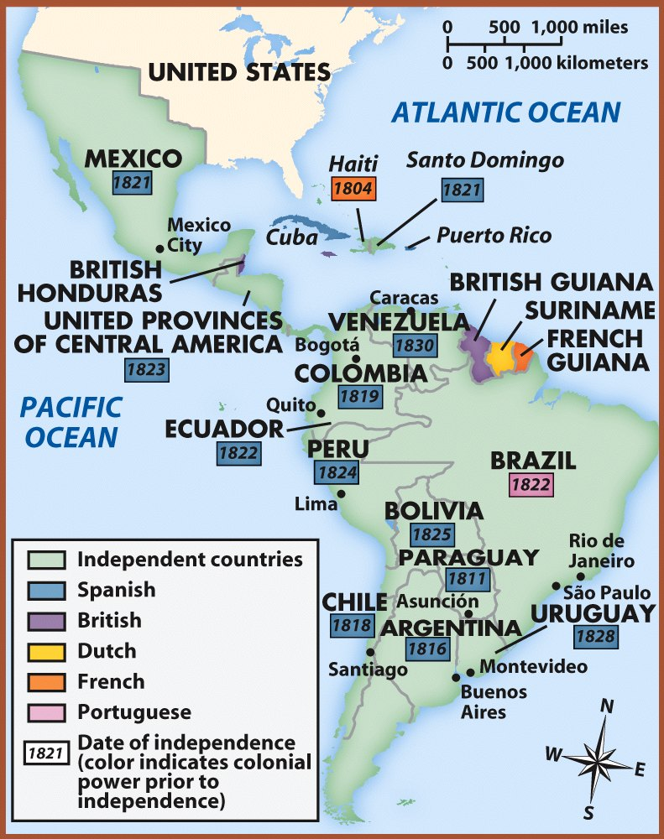
New Latin American countries were formed from successful revolutions.

Slide 12
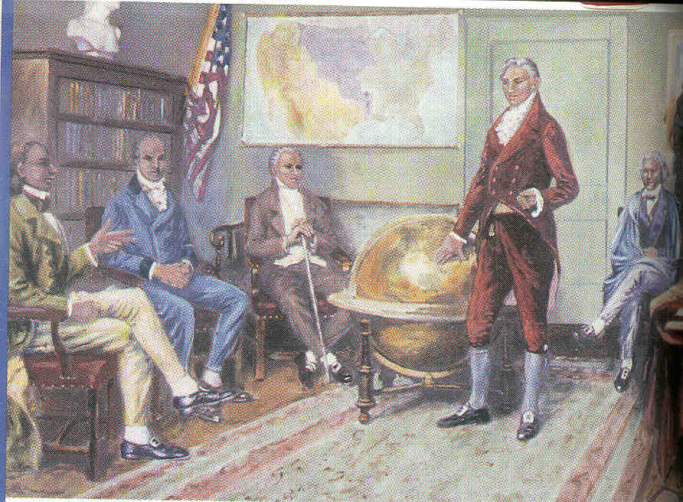
MONROE DOCTRINE
monroe doctrine
Monroe felt that he had to respond to the threat that European countries might try to win back their former Latin American colonies.
Thus, Monroe proclaimed the fundamental policy that bears his name, Monroe Doctrine.
Monroe told Europe: You stay out of the West, and we’ll stay out of your squabbles.
The doctrine also claimed America’s right to intervene anywhere in its own hemisphere, if it felt its security was threatened
This was a policy of mutual noninterference

Slide 13
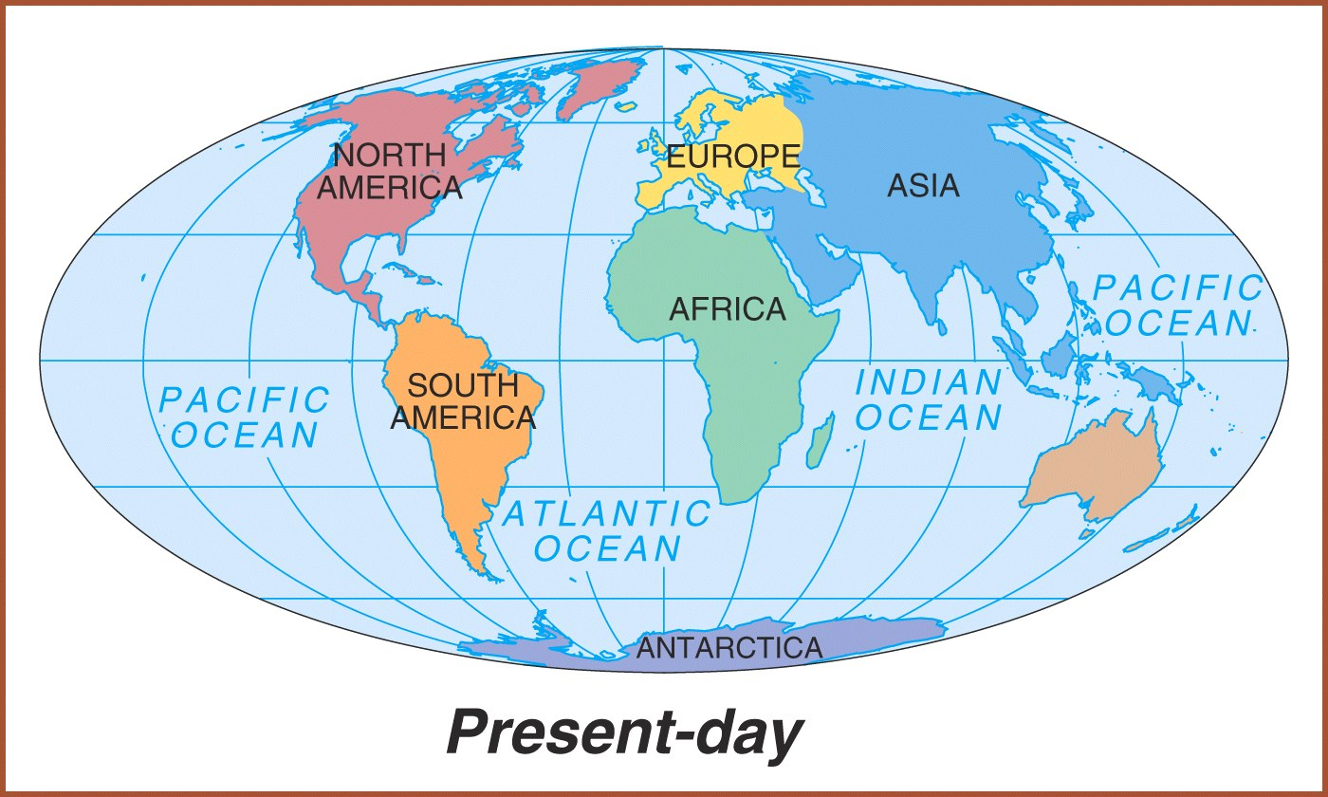
Western Hemisphere or the Americas.

Slide 14
Jan 3, 2017 Do Now:
Write the Objectives in your notes.
1. describe the social classes in the south.
2. Use example to support an analysis.

Slide 15
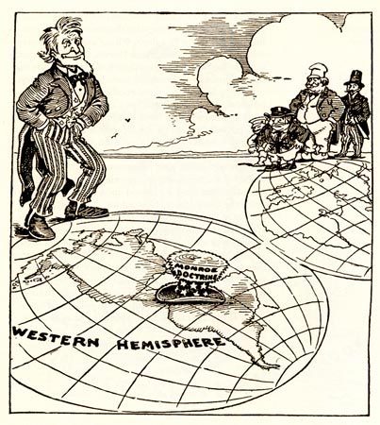
Consider this cartoon from the late 1800’s. Use it as Evidence to support your ideas about the Monroe Doctrine. Describe the Cartoon. What/ Who do you see? What are they doing? What does your observation say about the time period?

Slide 16
MONROE DOCTRINE
Referred to as America’s Self Defense Doctrine.
It is a continuation of President Washington’s neutrality and isolationist policies.
Past problems with Europe led the US to declare the Americas off-limits to Europe
US recognized existing European Colonies
US protector of new democracies in the Western Hemisphere
No European Colonization in the Americas
Monroe Doctrine
US will stay out of European affairs
Notes:
Responding to Russian territorial claims along the northern Pacific coast, and concerned that European nations would attempt to seize recently independent Latin American states, President James Monroe announced a new national policy. No new colonies would be allowed in the Americas, and European powers were not to interfere in the affairs of the Western Hemisphere. This mural depicts a discussion among the president and members of his cabinet; from left to right are President James Monroe, Secretary of State John Quincy Adams, Attorney General William Wirt, Secretary of War John Calhoun, and Secretary of the Navy Samuel L. Southard.

Slide 17
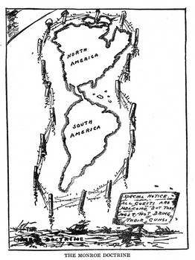

Slide 18
ERA OF GOOD FEELINGS
1817 TO 1825
american system
Spirit of Nationalism in US
patriotism or national oneness
Country is united, confident, and growing
1791-1819, 9 states joined the original 13.
One political party---Republican party
Respect from Europe
Monroe first president to visit all states.
Boston newspaper declared an “Era of Good Feelings” had began.
But, time period was not free of problems.

Slide 19
Wednesday Paragraph
How did the new Nationalism from the War of 1812 affect American Foreign Policy Under Monroe?
(Remember ! - Topic Sentence, Supporting evidence (two things) and a closing that wraps it all up.)
5 Sentences minimum!!!!

